Slide 1
Integration with a Web Application to Create Navigational Instructions for Locations on the Campus of Elizabeth City State University

Slide 2
Members
Je'Aime Powell
Mentor
Michael Austin
Undergrad Student
Andrew Brumfield
Undergrad Student
Nyema Barmore
Undergrad Student
Justin Deloatch
Grad Student

Slide 3
Overview
Purpose
Abstract
Research Questions
Methodology
Problem/Solutions
Conclusion
Future Works

Slide 4
Purpose

Slide 5
Abstract
Mashups are an exciting genre of interactive Web applications that draw upon content retrieved from external data sources to create entirely new and innovative services. The purpose of the Mobile Applications Research Team was to create an interface mashup in which geographic information and meta data from buildings located on the campus of Elizabeth City State University (ECSU) can be presented to users via mobile platforms. The project includes HTML5 programming which referenced a database that housed information such as location, building establishment date, academic departments, and academic programs. The information was then compiled using a PHP Hypertext Processor (PHP) form to populate a MySQL database. HTML5 coupled with PHP programming was then used to render a mobile web page with both map and database information.
Using Google Map Maker paths, streets, and buildings were created in appropriate geographic locations on the ECSU campus. The Google Maps Application Programming Interface was then used to generate Uniform Resource Locator's to both retrieve user Global Positioning System coordinates and create walking directions to selected locations. The user then had the ability to generate walking directions to locations on the university's campus.

Slide 6
Research Questions
How to add buildings, sidewalks, and streets to Google Maps?
How to generate walking directions?
How to extract Geo-location information from mobile devices?

Slide 7
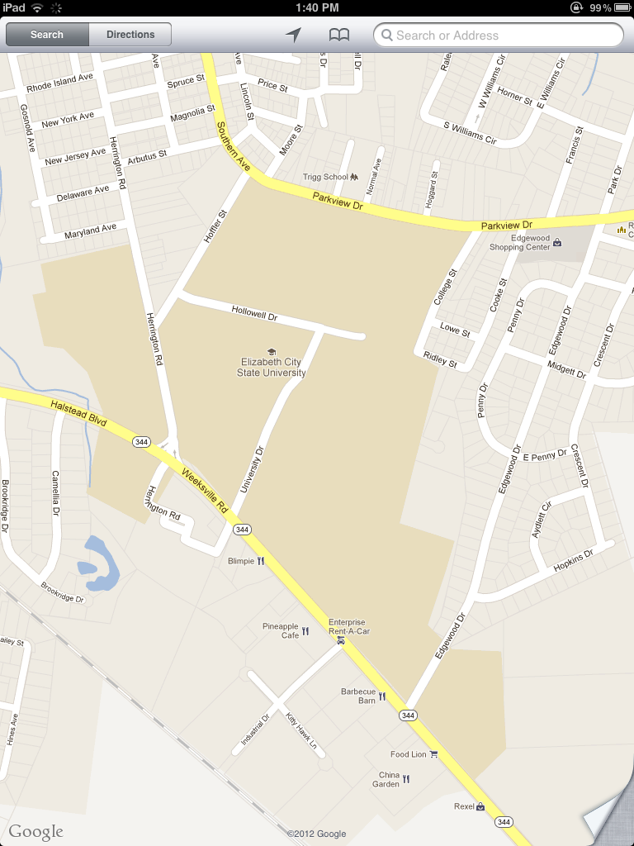
Methodology
Google Maps
No Buildings
Incorrect Streets
No walking paths

Slide 8
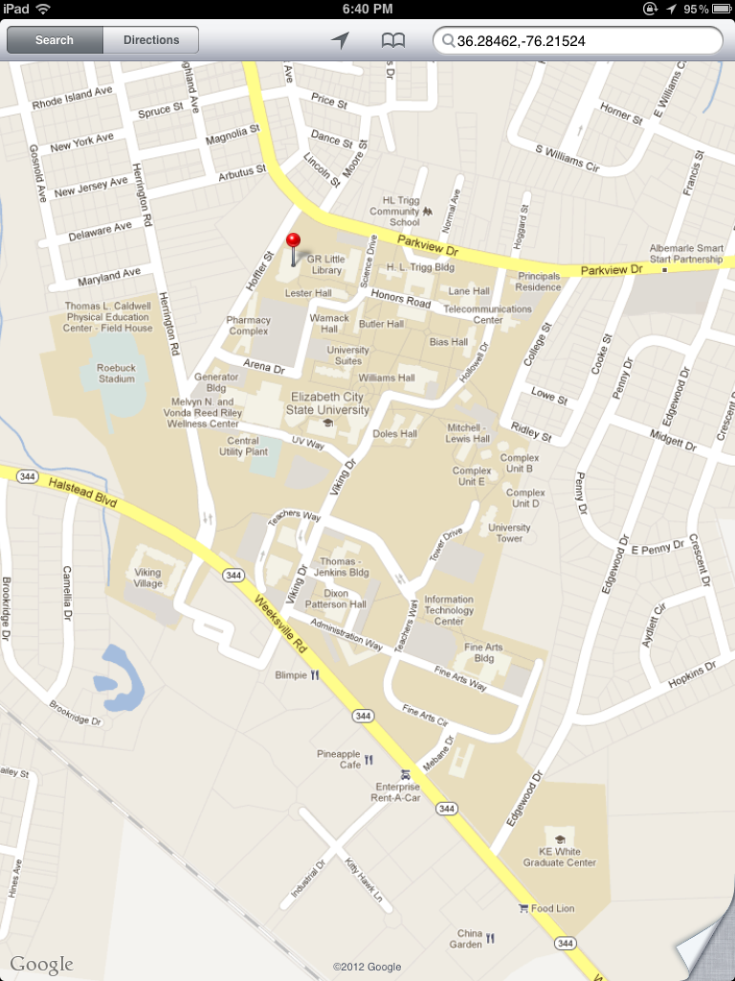
Methodology
Google Map Maker
Added Buildings
Added Street
Added Paths

Slide 9
Methodology
Google API
http://maps.google.com/maps?saddr=position.coords.latitude,position.coords.longitude&daddr=buildinglat,buildinglong&hl=en&&geocode=FbmlKQIdVQ91-w%3BFTykKQId8Bp1-w&dirflg=w&mra=ls&t=m&z=17

Slide 10
Methodology
Google API
http://maps.google.com/maps?saddr=position.coords.latitude,position.coords.longitude&daddr=buildinglat,buildinglong&hl=en&&geocode=FbmlKQIdVQ91-w%3BFTykKQId8Bp1-w&dirflg=w&mra=ls&t=m&z=17
HTML 5 Source Code
function initiate_geolocation() { navigator.geolocation.getCurrentPosition(handle_geolocation_query,handle_errors);

Slide 11
Methodology
Google API
http://maps.google.com/maps?saddr=position.coords.latitude,position.coords.longitude&daddr=buildinglat,buildinglong&hl=en&&geocode=FbmlKQIdVQ91-w%3BFTykKQId8Bp1-w&dirflg=w&mra=ls&t=m&z=17
PHP Source Code
<?php echo $row_DetailRS1['LATITUDE']; ?>,<?php echo $row_DetailRS1['LONGITUDE']; ?>

Slide 12
Problems/Solutions
Marked locations
Walking directions error

Slide 13
Problems/Solutions
Marked locations
Walking directions after re-indexing (April 4th, 2012)

Slide 14
Conclusions
How buildings, sidewalks and streets were added to Google Maps.
How walking directions were generated.
How geolocation information was extracted from mobile devices.

Slide 15
Future Works
Emergency Response Boxes (Blue Boxes)
ECSU Shuttle Bus
School Events
Check In Feature

Slide 16
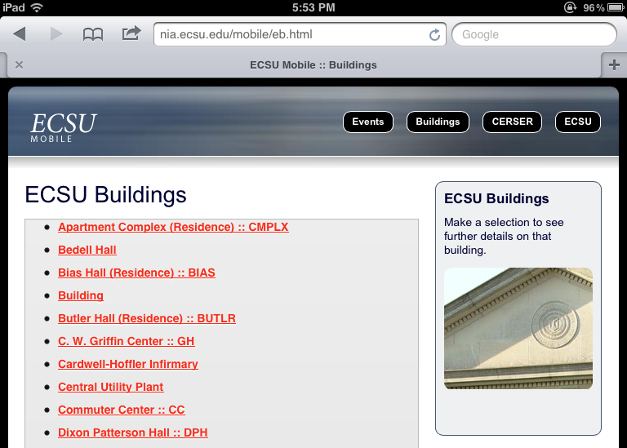
Demo
http://nia.ecsu.edu/mobile/eb.html

Slide 17
References

